Slide 1
Red-Black Trees

Slide 2
Red Black Tree
Red-Black tree is a binary search tree in which every node is colored with either red or black. It is a type of self balancing binary search tree.
Red Black Trees are self-balancing, meaning that the tree adjusts itself automatically after each insertion or deletion operation. It uses a simple but powerful mechanism to maintain balance, by coloring each node in the tree either red or black.

Slide 3
Red-Black Trees
The Red-Black tree satisfies all the properties of binary search tree in addition to that it satisfies following additional properties –
Root property: The root is black.
External property: Every leaf (Leaf is a NULL child of a node) is black in Red-Black tree.
Internal property: The children of a red node are black. Hence possible parent of red node is a black node.
Depth property: All the leaves have the same black depth.
Path property: Every simple path from root to descendant leaf node contains same number of black nodes.

Slide 4
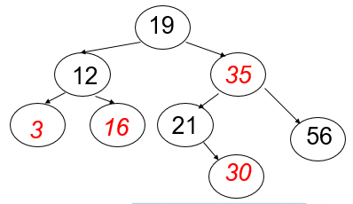
Rules That Every Red-Black Tree
Every node has a color either red or black.
The root of the tree is always black.
There are no two adjacent red nodes (A red node cannot have a red parent or red child).
Every path from a node (including root) to any of its descendants NULL nodes has the same number of black nodes.
Every leaf (e.i. NULL node) must be colored BLACK.

Slide 5
Red-Black Tree are preffered over AVL trees
The AVL trees are more balanced compared to Red-Black Trees, but they may cause more rotations during insertion and deletion.
So if your application involves frequent insertions and deletions, then Red-Black trees should be preferred.
And if the insertions and deletions are less frequent and search is a more frequent operation, then AVL tree should be preferred over the Red-Black Tree.

Slide 6
Applications of Red Black Trees
Most of the self-balancing BST library functions like map, multiset, and multimap in C++ ( or java packages like java.util.TreeMap and java.util.TreeSet ) use Red-Black Trees.
It is used to implement CPU Scheduling Linux.
Moreover, MySQL also uses the Red-Black tree for indexes on tables in order to reduce the searching and insertion time.
Red Black Trees are used in the implementation of the virtual memory manager in some operating systems, to keep track of memory pages and their usage.
Many programming languages such as Java, C++, and Python have implemented Red Black Trees as a built-in data structure for efficient searching and sorting of data.
Red Black Trees are used in the implementation of graph algorithms such as Dijkstra’s shortest path algorithm and Prim’s minimum spanning tree algorithm.
Red Black Trees are used in the implementation of game engines.

Slide 7
Advantages of Red Black Trees
Red Black Trees have a guaranteed time complexity of O(log n) for basic operations like insertion, deletion, and searching.
Red Black Trees are self-balancing.
Red Black Trees can be used in a wide range of applications due to their efficient performance and versatility.
The mechanism used to maintain balance in Red Black Trees is relatively simple and easy to understand.

Slide 8
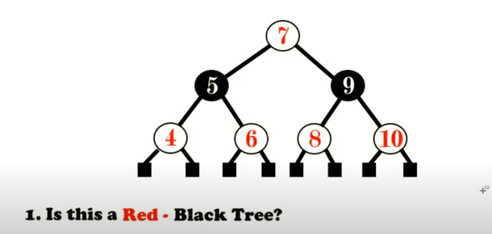
Checking the properties of Red-Black Tree - Example

Slide 9
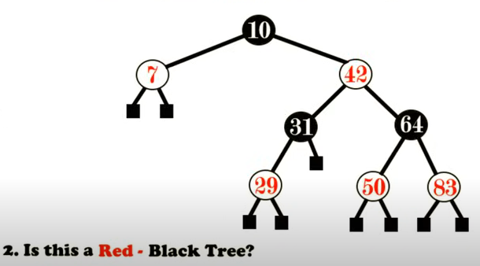
Checking the properties of Red-Black Tree - Example

Slide 10
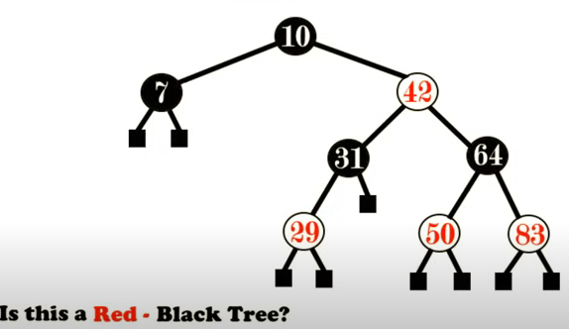
Checking the properties of Red-Black Tree - Example
Yes

Slide 11
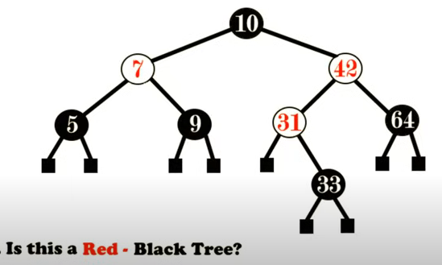
Checking the properties of Red-Black Tree - Example

Slide 12
Balancing in Red Black Tree
In the Red-Black tree, we use two tools to do the balancing:
Recoloring
Rotation
Recolouring is the change in colour of the node i.e. if it is red then change it to black and vice versa. It must be noted that the colour of the NULL node is always black. Moreover, we always try recolouring first, if recolouring doesn’t work, then we go for rotation.

Slide 13
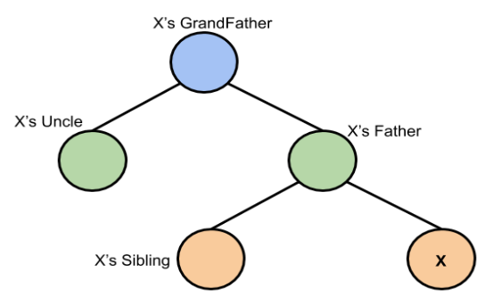
Representation considered for insertion

Slide 14
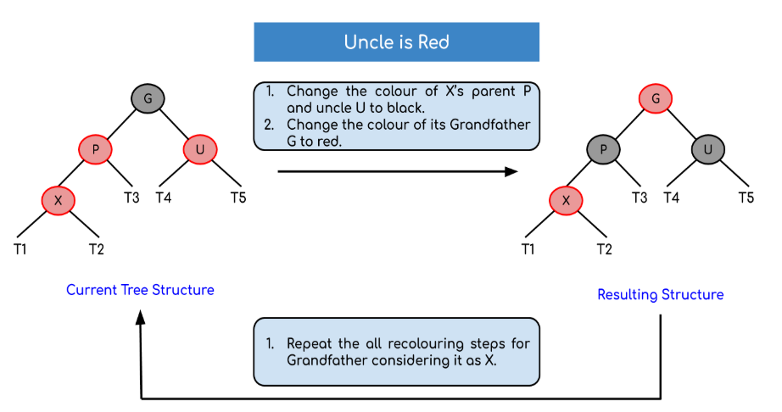
Case 1: Uncle is Red

Slide 15
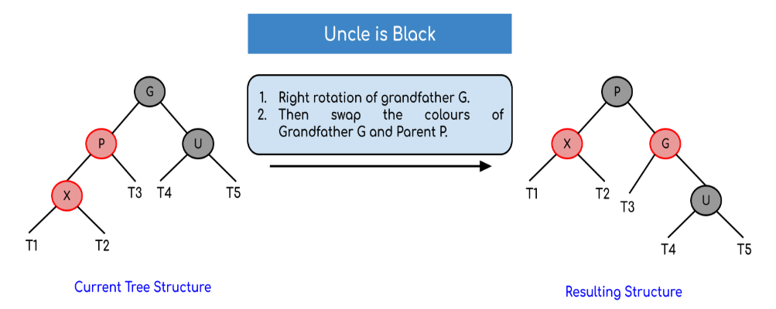
Case 2 : Uncle is Black – Left Left Case (LL rotation)
:

Slide 16
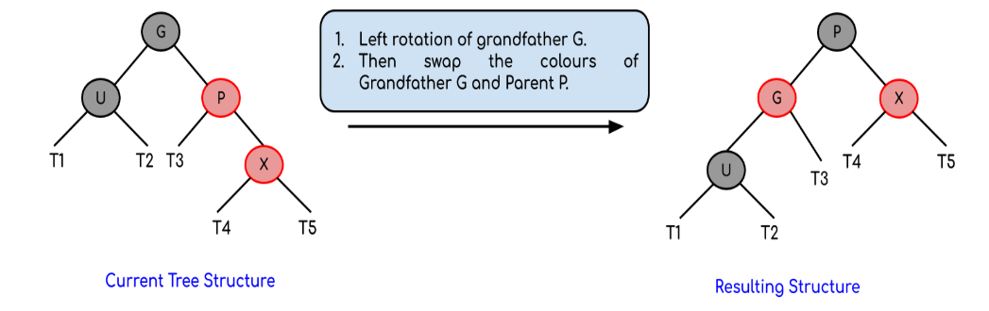
Case 2 : Uncle is Black – Right Right Case (RR rotation)

Slide 17
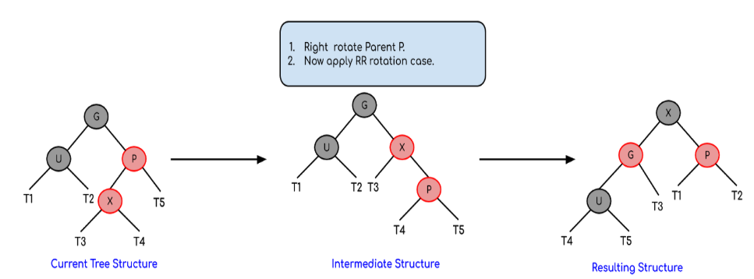
Case 2 : Uncle is Black – Right Left Case (RL rotation) Similarly for LR rotation

Slide 18
Insert in RB Tree
Perform standard BST insertion and make the colour of newly inserted nodes as RED.
If x is the root, change the colour of x as BLACK (Black height of complete tree increases by 1).
Do the following if the color of x’s parent is not BLACK and x is not the root. a) If x’s uncle is RED (Grandparent must have been black from property 4) (i) Change the colour of parent and uncle as BLACK. (ii) Colour of a grandparent as RED. (iii) Change x = x’s grandparent, repeat steps 2 and 3 for new x. b) If x’s uncle is BLACK, then there can be four configurations for x, x’s parent (p) and x’s
grandparent(g) (This is similar to AVL Tree) (i) Left Left Case (p is left child of g and x is left child of p) (ii) Left Right Case (p is left child of g and x is the right child of p) (iii) Right Right Case (Mirror of case i) (iv) Right Left Case (Mirror of case ii)
Re-coloring after rotations: For Left Left Case [3.b (i)] and Right Right case [3.b (iii)], swap colors of grandparent and parent after rotations For Left Right Case [3.b (ii)]and Right Left Case [3.b (iv)], swap colors of grandparent and inserted node after rotations

Slide 19

Example for Red Black Tree insertion
Example: Creating a red-black tree with elements 3, 21, 32 and 15 in an empty tree.

Slide 20

Insertion Example

Slide 21
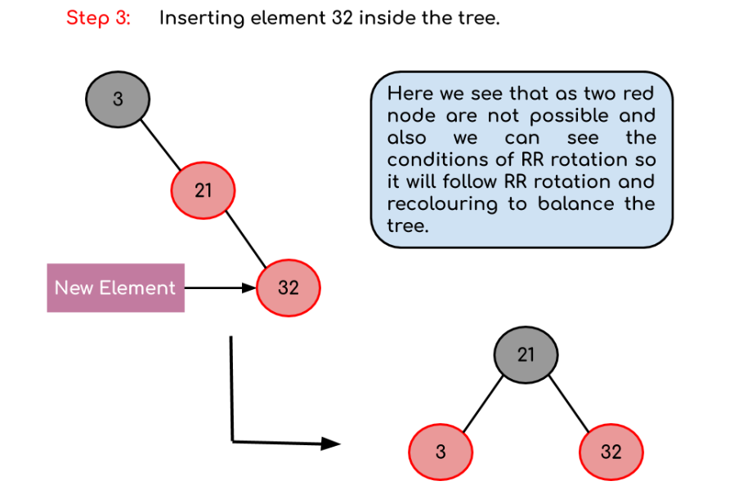
Insertion Example

Slide 22
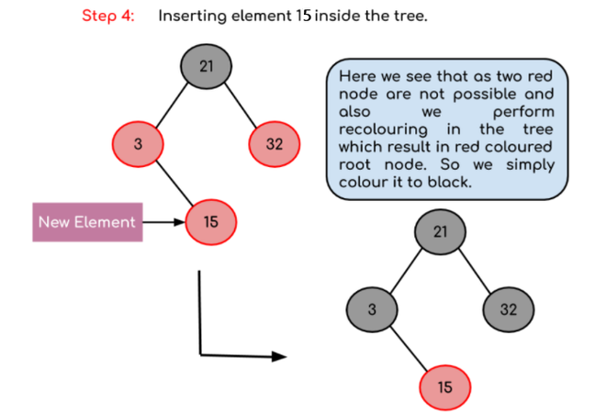
Insertion Example

Slide 23

Final Red Black Tree

Slide 24
Insertion Practice Exercise
Insert the values 2, 1, 4, 5, 9, 3, 6, 7 into an initially empty Red-Black Tree

Slide 25
Asymptotic Cost of Insertion
Insertion in RB Tree: O(log n)
O(lg n) to descend to insertion point
O(1) to do insertion
O(lg n) to ascend and readjust == worst case only for case 1

Slide 26
Reference
https://www.geeksforgeeks.org/introduction-to-red-black-tree/
https://www.geeksforgeeks.org/insertion-in-red-black-tree/
Introduction to Algorithms is a book on computer programming by Thomas H. Cormen, Charles E. Leiserson, Ronald L. Rivest, and Clifford Stein.

